Slide 1
What is Jenkins?
Jenkins is an open source automation tool written in Java programming language that allows continuous integration.
Jenkins builds and tests our software projects which continuously making it easier for developers to integrate changes to the project, and making it easier for users to obtain a fresh build.
It also allows us to continuously deliver our software by integrating with a large number of testing and deployment technologies.
With the help of Jenkins, organizations can speed up the software development process through automation. Jenkins adds development life-cycle processes of all kinds, including build, document, test, package, stage, deploy static analysis and much more.

Slide 2
For example
If any organization is developing a project, then Jenkins will continuously test your project builds and show you the errors in early stages of your development.
Possible steps executed by Jenkins are for example:
Execute a shell script
Archive a build result
Running software tests

Slide 3
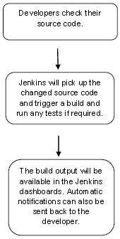
Work Flow:

Slide 4
What is Continuous Integration?
Continuous Integration (CI) is a development practice in which the developers are needs to commit changes to the source code in a shared repository at regular intervals.
Every commit made in the repository is then built. This allows the development teams to detect the problems early.

Slide 5
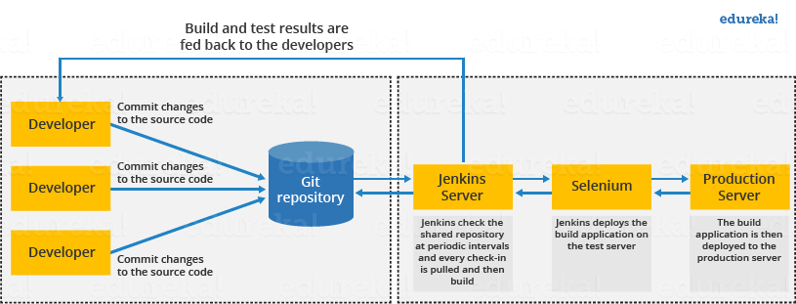
Continuous Integration with Jenkins
flow diagram of Continuous Integration with Jenkins

Slide 6
A developer commits the code to the source code repository. The Jenkins checks the repository at regular intervals for changes.
The Jenkins server finds the changes that have occurred in the source code repository. Jenkins will draw those changes and will start preparing a new build.
If the build fails, then the concerned team will be notified.
If built is successful, then Jenkins server deploys the built in the test server.
After testing, Jenkins server generates a feedback and then notifies the developers about the build and test results.
It will continue to verify the source code repository for changes made in the source code and the whole process keeps on repeating.

Slide 7
Advantages of Jenkins
It is an open source tool.
It is free of cost.
It does not require additional installations or components. Means it is easy to install.
Easily configurable.
It supports 1000 or more plugins to ease your work. If a plugin does not exist, you can write the script for it and share with community.
It is built in java and hence it is portable.
It is platform independent. It is available for all platforms and different operating systems. Like OS X, Windows or Linux.
Easy support, since it open source and widely used.
Jenkins also supports cloud based architecture so that we can deploy Jenkins in cloud based platforms.

Slide 8
Disadvantages of Jenkins
Not easy to maintain it because it runs on a server and requires some skills as server administrator to monitor its activity.
CI regularly breaks due to some small setting changes. CI will be paused and therefore requires some developer's team attention.

Slide 9
Jenkins Architecture
Jenkins follows Master-Slave architecture to manage distributed builds. In this architecture, slave and master communicate through TCP/IP protocol.
Jenkins architecture has two components:
Jenkins Master/Server
Jenkins Slave/Node/Build Server

Slide 10
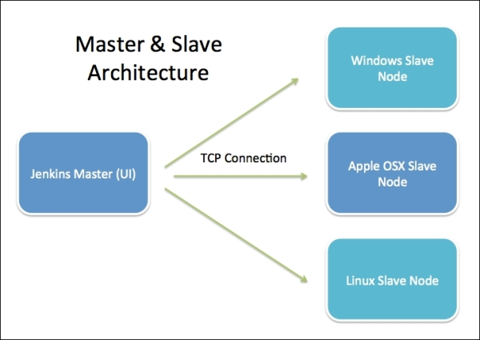
Jenkins Architecture

Slide 11
Jenkins Master
The main server of Jenkins is the Jenkins Master.
By default it runs on 8080 port.
By default one node (slave) is configured and running in Jenkins server.
We can add more nodes using IP address, user name and password using the ssh, jnlp or webstart methods.

Slide 12
master's job is to handle:
Scheduling build jobs.
Dispatching builds to the nodes/slaves for the actual execution.
Monitor the nodes/slaves (possibly taking them online and offline as required).
Recording and presenting the build results.
A Master/Server instance of Jenkins can also execute build jobs directly.

Slide 13
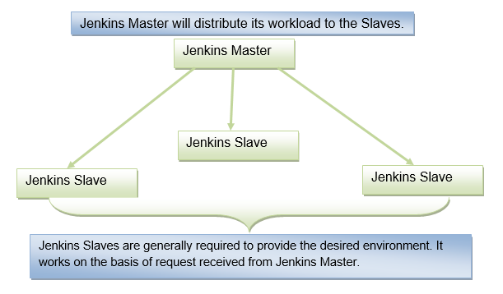
Jenkins Slave
Jenkins slave is used to execute the build jobs dispatched by the master. We can configure a project to always run on a particular slave machine
Jenkins is developed using Java is platform independent thus Jenkins Master/Servers and Slave/nodes can be configured in any servers including Linux, Windows, and Mac.

Slide 14
Before and After Jenkins
Before Jenkins | After Jenkins
The entire source code was built and then tested. | Every commit made in the source code is built and tested.
Developers have to wait for test results | Developers know the test result of every commit made in the source code on the run.
The whole process is manual | You only need to commit changes to the source code and Jenkins will automate the rest of the process for you.

Slide 15
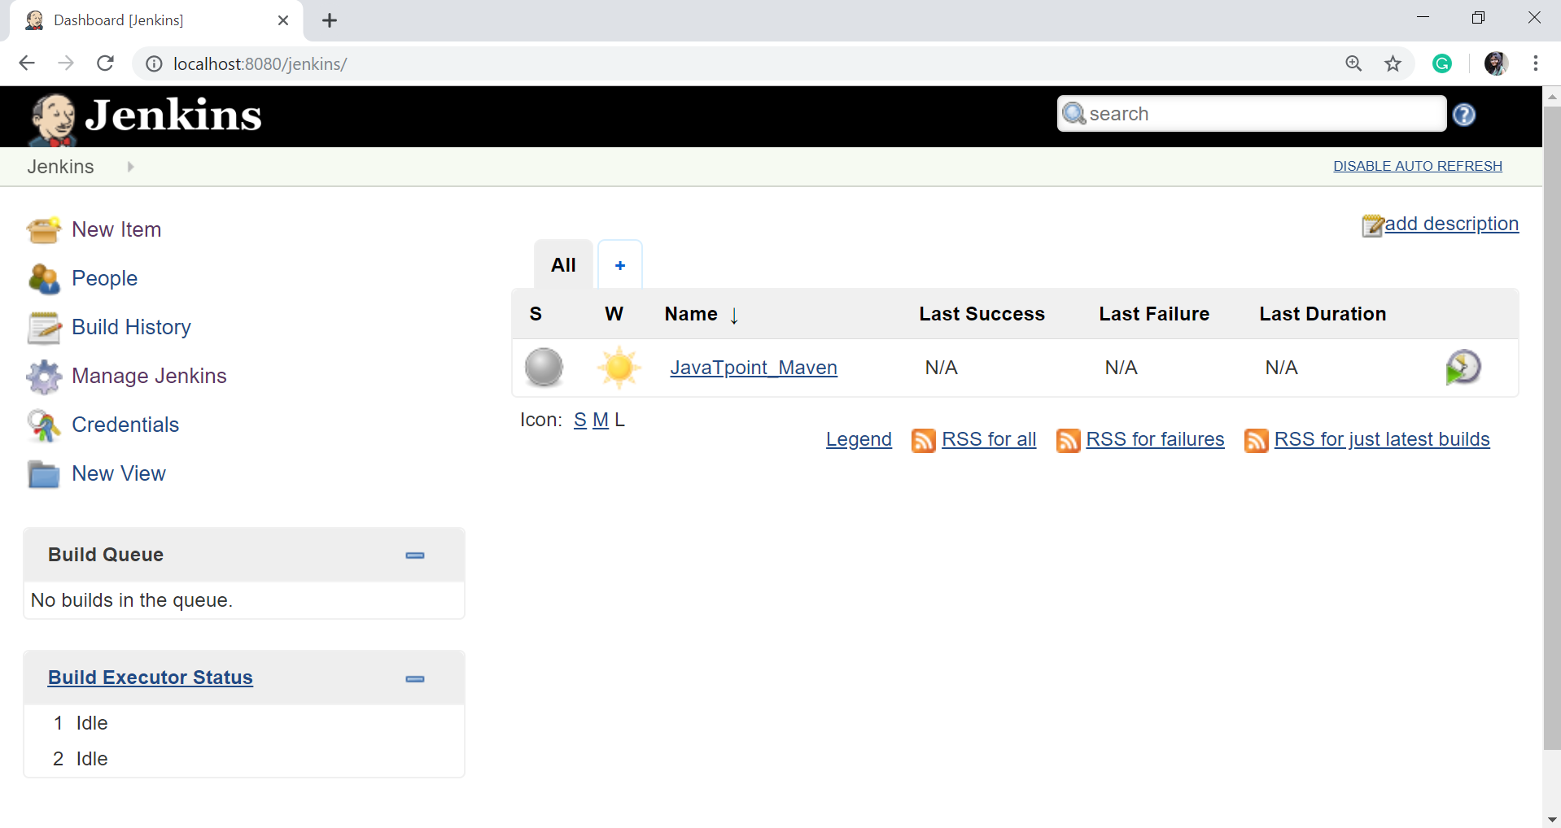
Jenkins Configuration
To configure the Jenkins, click on the 'Manage Jenkins' menu option from the left-hand side of the Jenkins Dashboard screen.

Slide 16
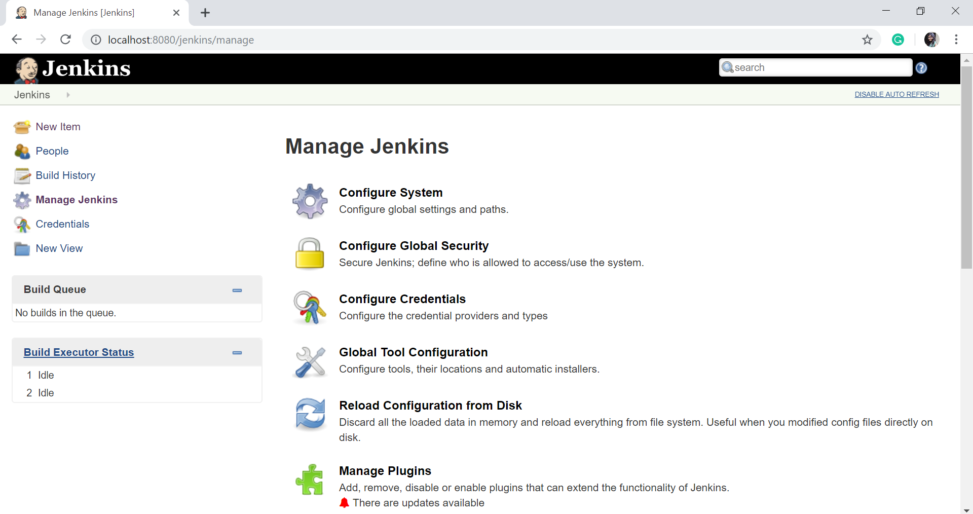
On the Manage Jenkins page, you will see the following options:
Configure System Click on the 'Configure System

Slide 17
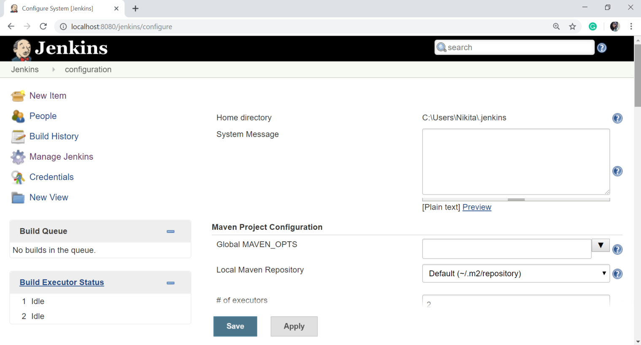
Click on the 'Configure System'. It will show the following options
The configure system page is a critical configuration part. This screen represents a variety of sections, each correlating to a different configuration area from generic Jenkins settings, global environment variables, and most installed plugins are configured on this page.

Slide 18
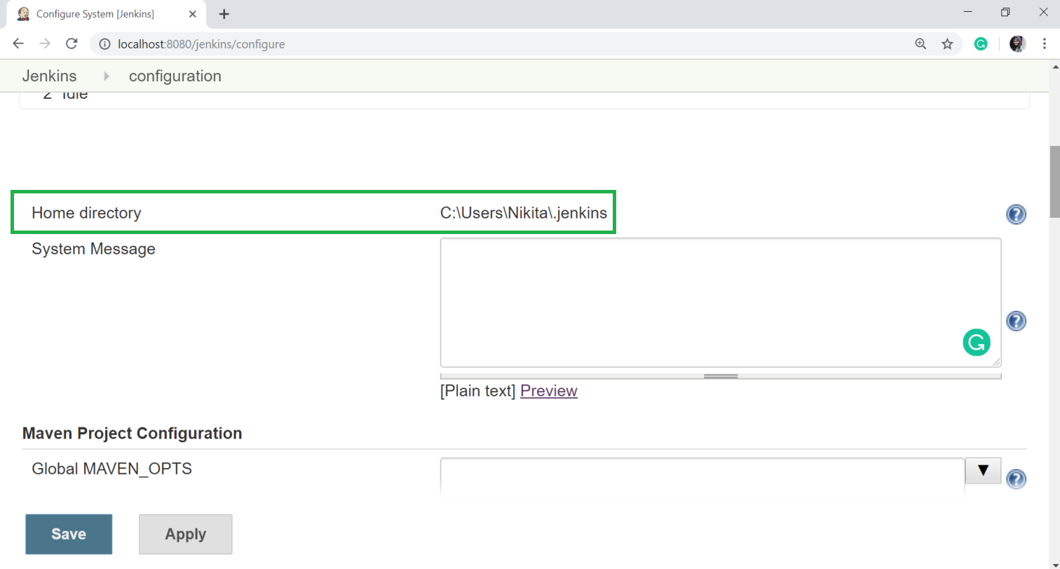
Home directory
Jenkins requires some disk space to perform builds and keep archives. You can check this location from the configuration screen of Jenkins.
By default, this is set to ~/.jenkins, and this location will be initially stored within your user profile (such as C:\Users\Nikita\.jenkins) location.

Slide 19
You can change this location to a different location to store all relevant builds and archives. We can do this in the following ways:
Set environment variable of JENKINS_HOME to the new home directory before launching the servlet container.
Set system property of JENKINS_HOME to the servlet container.
Set JNDI (Java Naming and Directory Interface) environment entry JENKINS_HOME to the new directory.

Slide 20
To set the JENKINS_HOME environment variable.
First, create a new folder in any directory. And copy all the contents from the ~/.jenkins to a new folder.
Set the JENKINS_HOME environment variable to the newly created folder, which is also pointing to the base directory location where Java is installed on your machine.
Now, in the Jenkins dashboard, click on the Manage Jenkins from the left-hand side menu, and then click on the Configure System from the right-hand side.

Slide 21
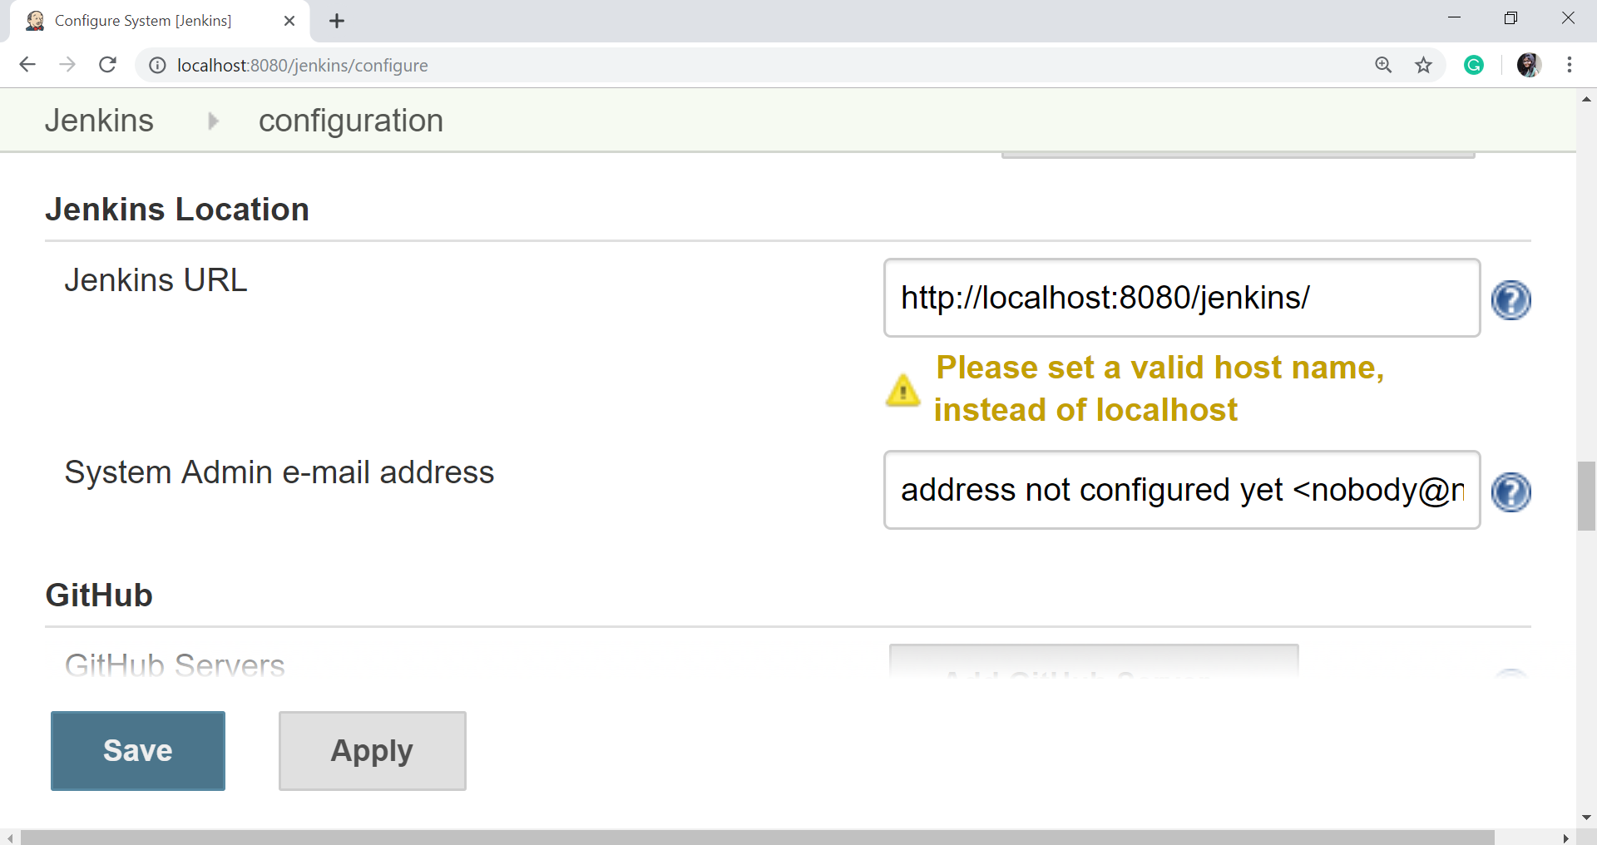
Jenkins URL
By default, the Jenkins URL is set to the localhost. If you have a DNS (domain name setup) for your machine, set this to the domain name else overwrite localhost with the IP of machine.
This will help in setting up slaves (nodes) and while sending out links using the email as you can directly access the Jenkins URL using the environment variable JENKINS_URL which can be accessed as ${JENKINS_URL}.

Slide 22
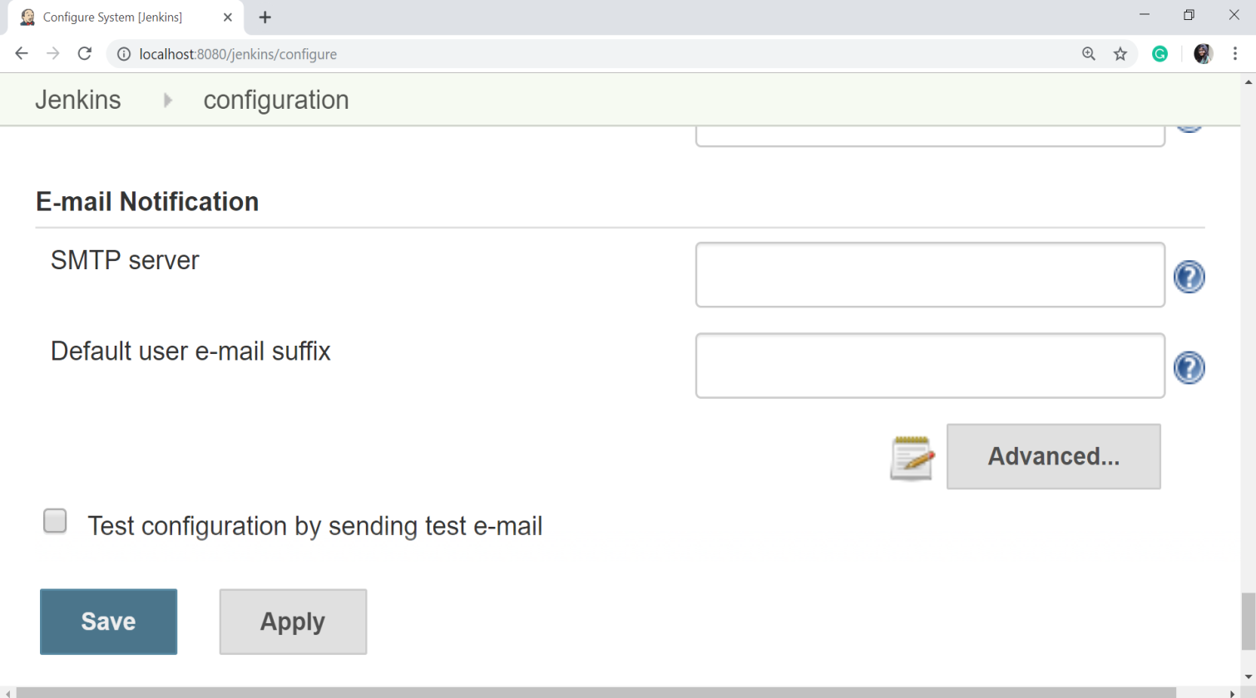
Email Notification
In the Email Notification section, you can configure the SMTP settings for sending out emails. This needs for Jenkins to connect to the SMTP mail server and send out emails to the recipient list.

Slide 23
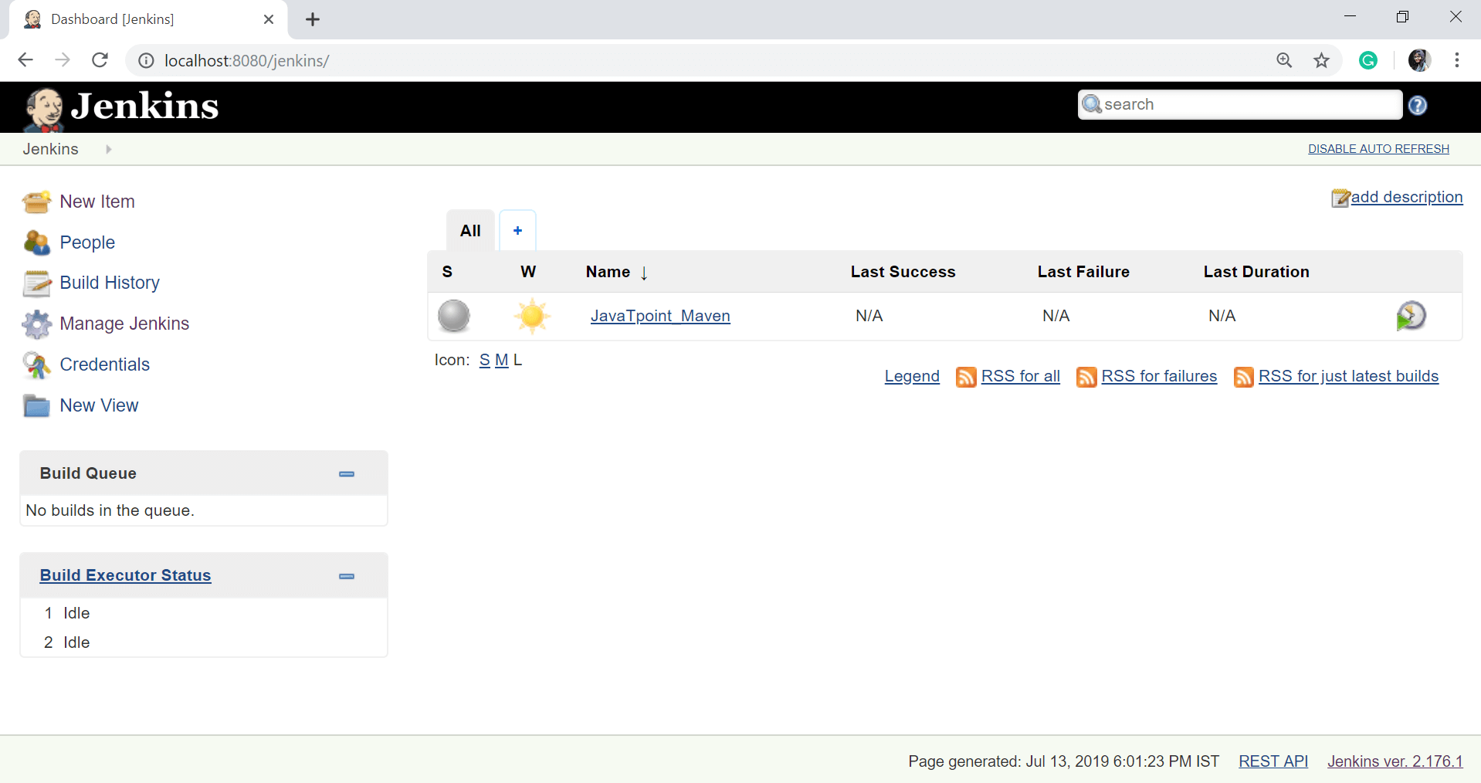
Jenkins - Management
To manage Jenkins, click on the "Manage Jenkins" option from the left hand of the Jenkins Dashboard page.

Slide 24
When you click on the Manage Jenkins, you will get the various options to manage the Jenkins:
Configure System
Configure Global Security
Configure Credentials
Global Tool Configuration
Reload Configuration from Disk
Manage Plugins
System Information
System Log
Load Statistics
Jenkins CLI
Script Console
Manage Nodes
About Jenkins
Manage Old Data and
Prepare for Shutdown

Slide 25
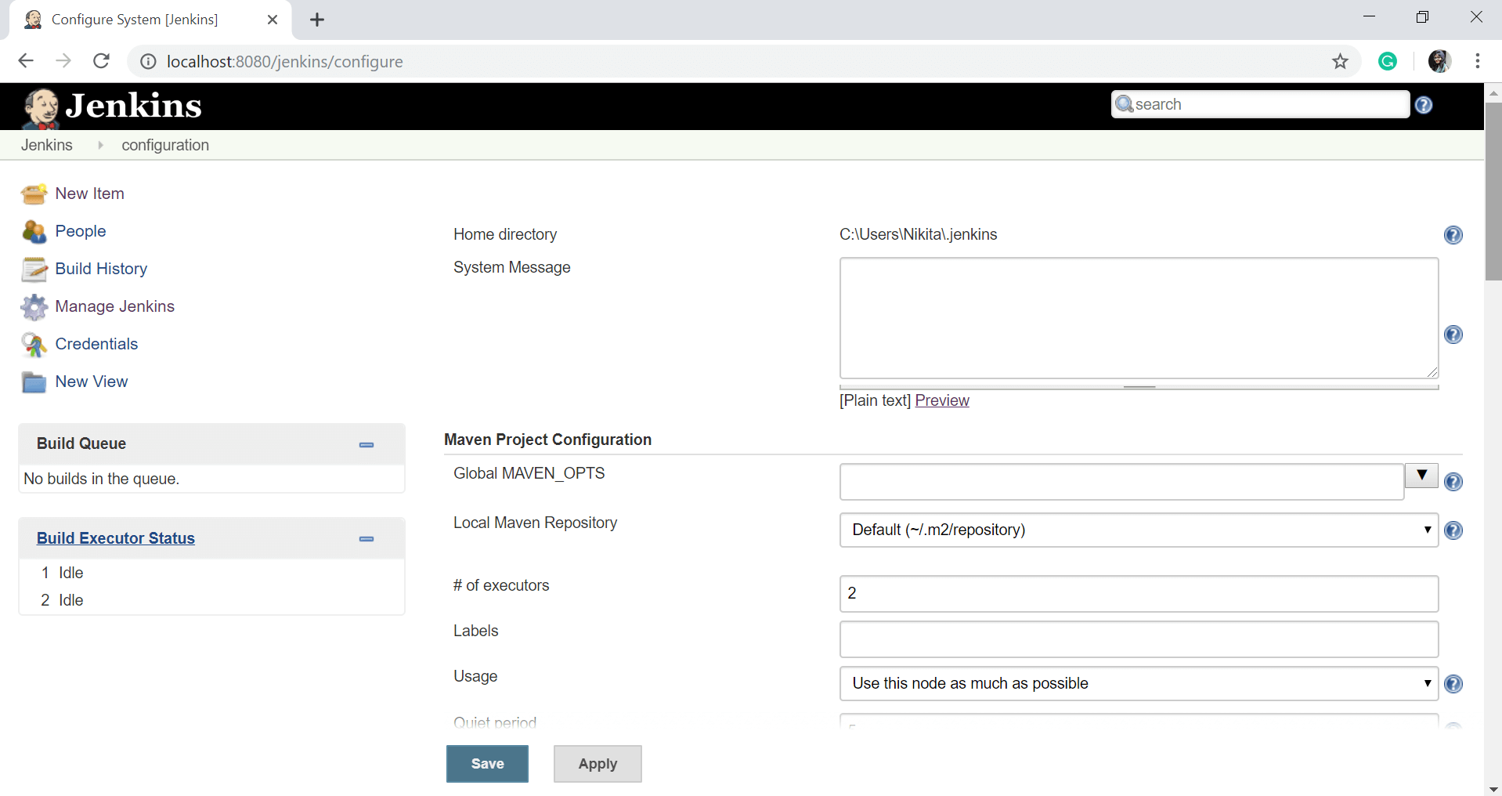
Configure System
In this, we can manage paths to the various tools to use in builds, such as the versions of Ant and Maven, as well as security options, email servers, and other system-wide configuration details. Jenkins will add the required configuration fields dynamically when new plugins are installed.

Slide 26
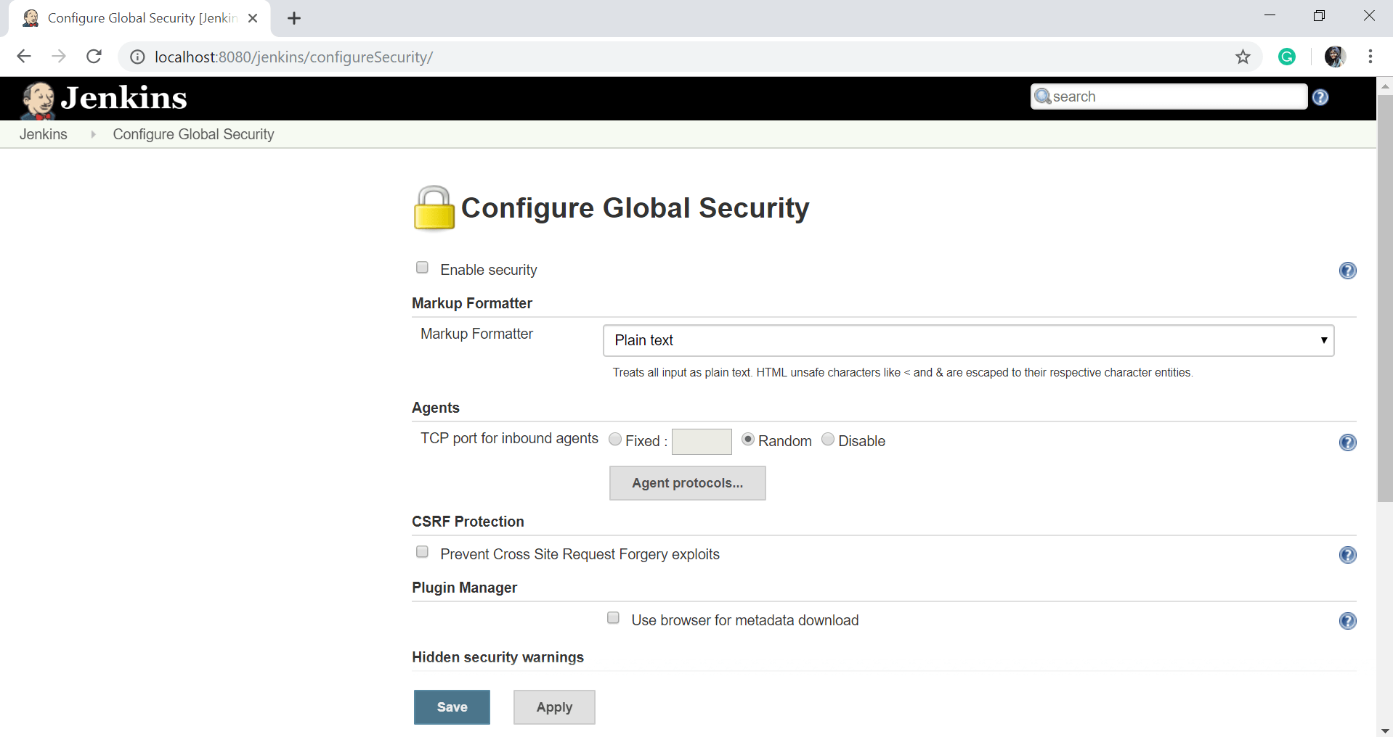
Configure Global Security
Configure Global Security option provides the ability to set up users and their relevant permissions on the Jenkins instance. By default, you will not want everyone to be able to define builds or other administrative tasks in Jenkins. So Jenkins provides the ability to have a security configuration in place.

Slide 27
Reload Configuration from Disk
Jenkins stores all its system and job configuration details as XML files and all XML files are stored in the Jenkins home directory. Jenkins also stores all of the build histories.
Manage Plugin
Here you can install a wide or different variety of third-party plugins from different Source code management tools such as Git, ClearCase or Mercurial, to code quality and code coverage metrics reporting. We can download, install, update, or remove the plugins from the Manage Plugins screen.
System Information
This option displays a list of all the current Java system properties and system environment variables. Here you can check what version of Java is currently running in, what user it is running under, and so forth.

Slide 28
System Log
The System Log option is used to view the Jenkins log files in real time. As well as, the main use of this option is for troubleshooting.
Jenkins CLI ( Command Line Interface)
Using this option, you can access various features in Jenkins through a command-line. To run the Jenkins through cli, first you have to download the Jenkins-cli.jar file and run it on your command prompt as follows:
java -jar jenkins-cli.jar -s http://localhost:8080/jenkins/
Script Console
This option allows you to run Groovy scripts on the server. This option is very useful for advanced troubleshooting since it requires a strong knowledge of the internal Jenkins architecture.
Manage nodes
Jenkins can handle parallel and distributed builds. In this page, you can configure how many builds you want. Jenkins runs concurrently, and, if you are using distributed builds, set up builds nodes. A build node (slave) is another machine that Jenkins can use to execute its builds.
About Jenkins
This option will show the version and license information of the Jenkins you are running. As well as it displays the list of all third party libraries.
Prepare for Shutdown
To shut down Jenkins cleanly, you can use the Prepare for Shutdown link, which prevents any new builds from being started.

Slide 29
Scheduling a Job in Jenkins
Two types of Scheduling a jobs in Jenkins – PollSCM and Build Periodically
The steps for schedule jobs in Jenkins:
click on "Configure" of the job requirement.
scroll down to "Build Triggers" - subtitle.
Click on the checkBox of Build periodically or PollSCM.

Slide 30
The main difference between the two is :
Poll SCM
Periodically polls the SCM to check whether changes were made (commits), and triggers the job if new commits where pushed.
Build periodically
Triggers the job periodically even if nothing is changed.

Slide 31
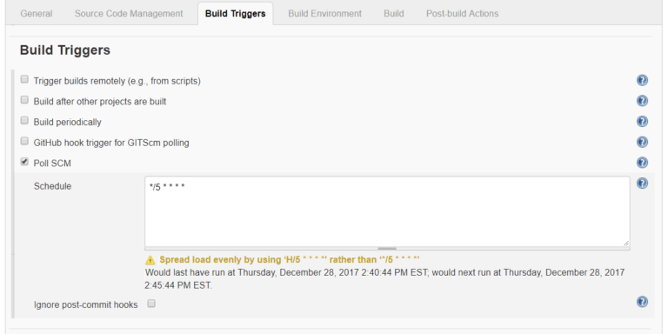
Poll SCM
This is a good option when you want to periodically check for new commits to your repository
when you have lots of commits in short periods of time this option may also save you time and resources.
To set periodically scheduled Jenkins jobs you should use Configure - Build Triggers - Poll SCM - Schedule
Let's type */5 * * * * in this box, which means we want to schedule the job to run every 5 minutes

Slide 32
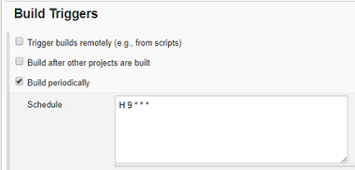
Build periodically
Under Build Triggers - Build periodically - Schedule you can create a schedule (or multiple schedules) for Jenkins to build periodically or on a specific date/time.
To set periodically scheduled Jenkins jobs you should use Configure - Build Triggers - Build periodically - Schedule
Let's type H 9 * * * in this box, which means we want to schedule the job to run every 9 hours

Slide 33
Jenkins schedule format
Jenkins schedule format is nothing but a cron schedule expression. It contains 5 fields
┌───────────── minute (0 - 59)
│ ┌───────────── hour (0 - 23)
│ │ ┌───────────── day of month (1 - 31)
│ │ │ ┌───────────── month (1 - 12)
│ │ │ │ ┌───────────── day of week (0 - 6) (Sunday to Saturday;
│ │ │ │ │ 7 is also Sunday on some systems)
│ │ │ │ │
│ │ │ │ │
* * * * * schedule command to execute

Slide 34
Jenkins build periodically - examples
Build every hour:
H * * * *
Build every 20 minutes:
H/20 * * * *
Build every 20 minutes 5am to 11pm:
H/20 5-23 * * *
Build every 20 minutes, work time/days (8am-6pm, MON-FRI) only:
H/20 8-18 * * 1-5
Build every hour MON-WED and FRI only:
H * * * 1-3,5
Build every hour, weekends in April and December:
H * * 4,12 *
Build at 8.30am on July 4:
30 8 4 7 *

Slide 35
Maven Build Scripts (Setup)
Maven is a powerful project management and comprehension tool that provides complete build life cycle framework to assist developers.
It is based on the concept of a POM (Project Object Model) that includes project information and configuration information
Maven is build automation tool used basically for Java projects, though it can also be used to build and manage projects written in C#, Scala, Ruby, and other languages.

Slide 36
How to setup Jenkins for a Maven project
Step 1 – Starting Jenkins
Step 2 – Creating and configuring user on Jenkin
Step 3 – Configuring System
Step 4 – Adding Plugins
Step 5 – Creating jobs
Step 6 – Build the jobs

Slide 37
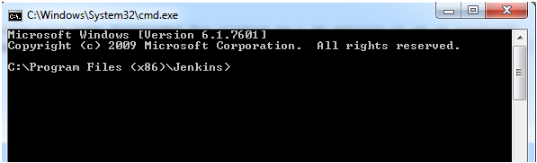
Step 1 – Starting Jenkins
a) Download Jenkins Zip file and extract it
b) In cmd go to the path you have extracted Jenkins (eg.C:\Program Files (x86)\Jenkins)
c) To start the Jenkins, run the command jenkins.exe start -To restart the Jenkins: Jenkins.exe restart -To stop the Jenkins: Jenkins.exe stop
d) By default, it will open up on 8080 port as localhost:8080

Slide 38
Step 2 – Creating and configuring user on Jenkins
a) To create a user go to Manage Jenkins->Manage Users->Create User->Provide the required information
b) Go to Manage Jenkins->Configure Global Security -Check Enable security -In Security Realm, select Jenkins own user database and check Allow users to sign up -In authorization, there are multiple options select as per requirement -Save once done

Slide 39
Step 3 – Configuring System
a) Go to Manage Jenkins->Configure System
b) Configure JDK -Give the JDK name -JAVA_HOME : C:\Program Files\Java\jdk1.7.0_45
c) Maven configuration -Give a maven name -MAVEN_HOME : C:\apache-maven-3.2.5\apache-maven-3.2.5- bin\apache-maven-3.2.5
d) Global Maven_OPTS –Xmx512m –XX:MaxPermSize=128m
e) Save once done

Slide 40
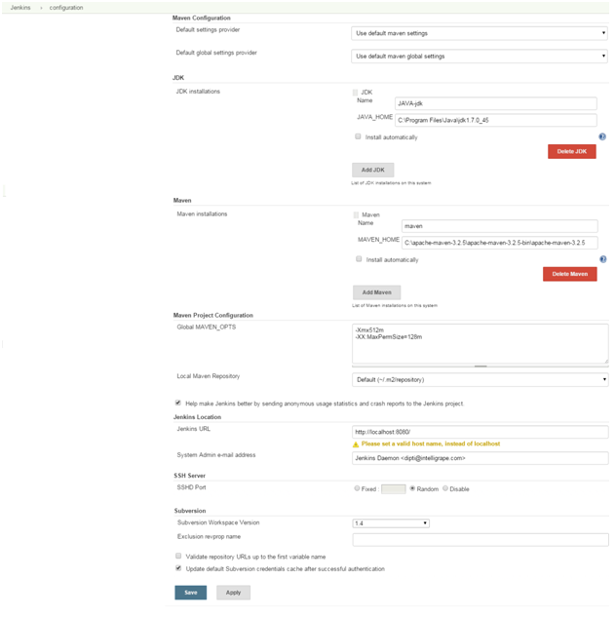

Slide 41
Step 4 – Adding Plugins
a) Go to Manage Jenkins->Add Plugins
b) Install the plugins which are required, Eg. GIT client plugin: which Shared library plugin for other Git related Jenkins plugins, GIT plugin: This plugin integrates GIT with Jenkins etc.
Step 5 – Creating jobs
a) Go to New Items->Give a project name in “Item name” field->select Maven project->click OK
b) Now configure the job -Provide the description -In Source Code Management, there are options for CVS project, Git etc, select the one which is required

Slide 42
Step 5 – Creating jobs
– In Build Triggers, there are multiple options like “Build when a change is pushed to GitHub”, “Poll SCM”, “Build whenever a SNAPSHOT dependency is built” etc, select the required one – Give the path of your pom.xml file in Build Root POM – Give “Goals and options“ take a use case where the requirement is to install the code then give ”clean install”
c) Configure the job and don’t forget to save
Step 6 – Build the jobs
Now build the job “4502_deploy”, on successful completion “4503_deploy” will trigger automatically and hopefully, jobs will be successful!!!

Slide 43
Jenkins - Security
In Jenkins you have the ability to setup users and their relevant permissions on the Jenkins instance.
By default you will not want everyone to be able to define jobs or other administrative tasks in Jenkins.
So Jenkins has the ability to have a security configuration in place.

Slide 44
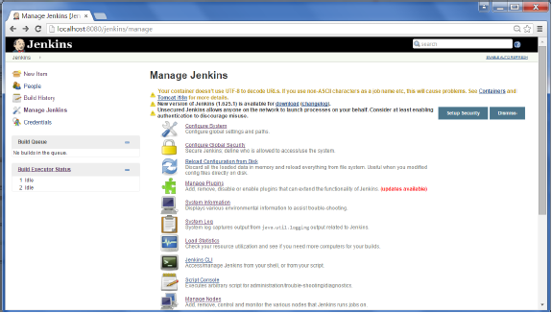
To configure Security in Jenkins, follow the steps given below…
Step 1 − Click on Manage Jenkins and choose the ‘Configure Global Security’ option.

Slide 45
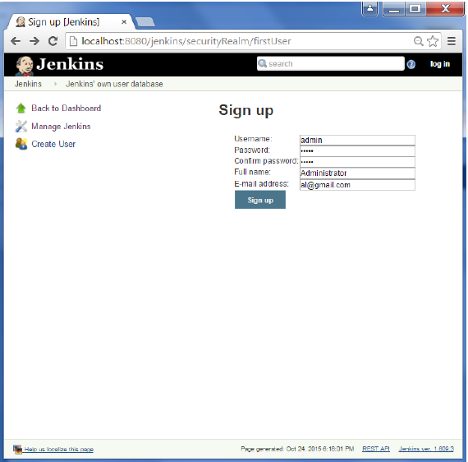
To configure Security in Jenkins, follow the steps given below
Step 2 − Click on Enable Security option and save.
Step 3 − You will be prompted to add your first user. As an example, we are setting up an admin users for the system.

Slide 46
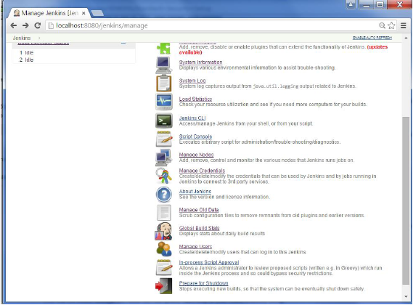
To configure Security in Jenkins, follow the steps given below
Step 4 − To setup your users in the system. Now when you go to Manage Jenkins, and scroll down, you will see a ‘Manage Users’ option. Click this option.

Slide 47
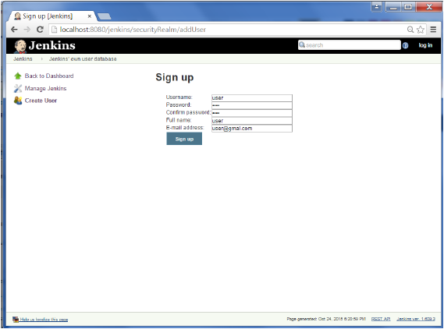
To configure Security in Jenkins, follow the steps given below
Step 5 − Just like you defined your admin user, start creating other users for the system. As an example, we are just creating another user called ‘user’.

Slide 48
To configure Security in Jenkins, follow the steps given below
Step 6 − To setup your authorizations, Go to Manage Jenkins → Configure Global Security.
Authorization Strategies
Anyone can do anything is pretty self-explanatory.
Legacy mode isn’t much more useful, as it only gives you two levels of access: “admin” which has full control, and everyone else (including anonymous users) has read-only.
Logged-in users can do anything is only useful if you’d like everyone to have auditable admin access, and probably isn’t very useful outside of smaller teams.

Slide 49
Authorization Strategies
Matrix-based security - It allows you to grant specific permissions to users and groups.
The Matrix-based security plugin enables the operator to configure the following types of permissions:
Overall - Either Administer or Read permissions can be set overall.
Credentials - Permissions to create, delete, update, and view authentication credentials, and manage domains.
Job - Permissions for specific operations on Jenkins jobs, including build creation, configuration, and execution.
Run - Permissions to run and rerun jobs.
View - Permissions to manage views in the Jenkins UI.
SCM - Permissions to use SCM tags.

Slide 50
To configure Security in Jenkins, follow the steps given below
Step 7 − If you don’t see the user in the user group list, enter the user name and add it to the list. Then give the appropriate permissions to the user.
Click on the Save button once you have defined the relevant authorizations.

Slide 51
Jenkins Workspace Management
The workspace directory is where Jenkins builds your project: it contains the source code Jenkins checks out, plus any files generated by the build itself. This workspace is reused for each successive build

